Slide 1
Disk Forensics

Slide 2
Tools Needed
Disk Images
https://drive.google.com/file/d/1B6EdVuz9OROu1vzsuus3y0LlP_7k-Lws/view?usp=sharing
Active Disk Editor
https://www.disk-editor.org/index.html
dd (should be installed by default)
fdisk
sudo apt install fdisk
Hex editor
Hexdump (should be installed by default)
hxd
https://mh-nexus.de/en/hxd/

Slide 3
File Systems

Slide 4
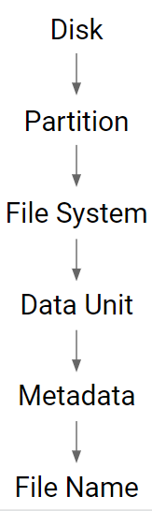
Disk Hierarchy
Disk - Stores all of the information on the machine
Partition - A logical division of the disk
File System - Controls how data is stored and retrieved
Data Unit - A grouping of consecutive sectors that hold the file contents
Metadata - Data that describes a file
Filename - Data that assigns a name to each file

Slide 5
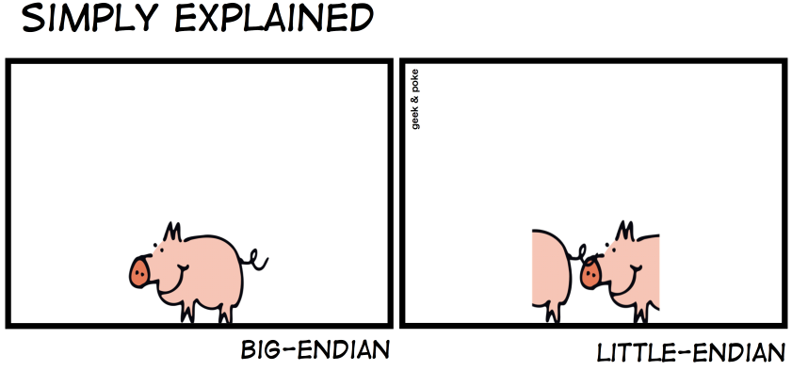
Terms to Know
Sector - The smallest unit on a disk, normally 512 bytes but can change
Cluster - A group of consecutive sectors
Little Endian - The least significant byte is stored at the smallest address
If in memory we have 0x1A 2B 3C then it is actually the value 0x3C 2B 1A
Little endian is used whenever the value being stored is a number
Big Endian - The most significant byte is stored at the smallest address
If in memory we have 0x1A 2B 3C then it is actually the value 0x1A 2B 3C
Big endian is used when storing words or strings

Slide 6
Commands to Know
fdisk - Gives information about the disk image
l → list disk information
dd - Convert and copy file
if → Input file
of → Output file
bs → Block/Sector size
hexdump - Displays the contents of binary files in hexadecimal
C → Hex and ASCII output
s → Skip Number of Bytes
n → Number of Bytes to Display
Math in bash
$(( 512 * 4 ))

Slide 7
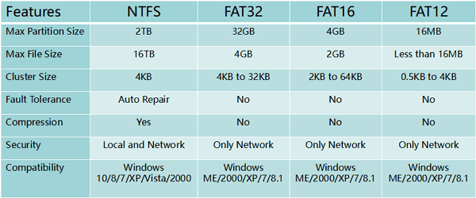
File System Comparison

Slide 8
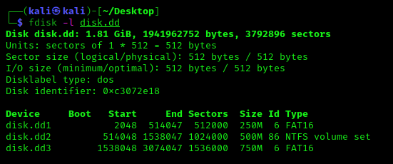
Disk Information

Slide 9
FAT16 File System

Slide 10
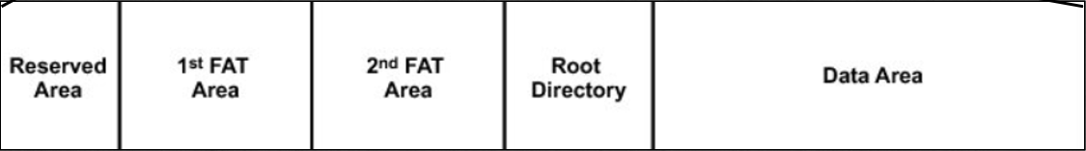
FAT16 Architecture
Reserved Area - Boot sector code
Contains # of FATs, Sector Size, Sectors a Cluster, Allows Determination of Root Directory Location
1st FAT Area - The location of the first file allocation table
Free Cluster → 0x0000
Occupied Cluster → 0x0002 - 0xFFEF
End of Cluster → 0xFFFF
Root Directory
Filenames
File Attributes
File Size
File Starting Cluster
Data Area - Where the files/data is stored

Slide 11
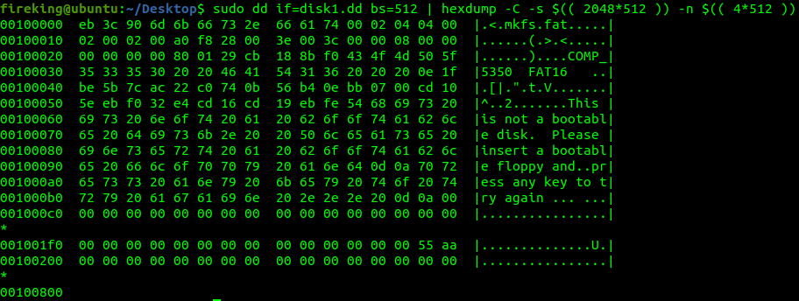
Reserved Area/Boot Sector

Slide 12
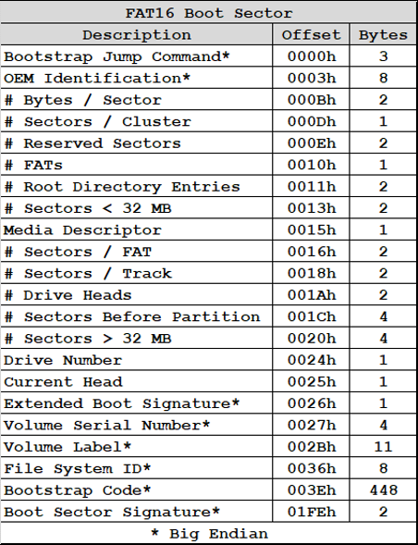
Reserved Area/Boot Sector

Slide 13
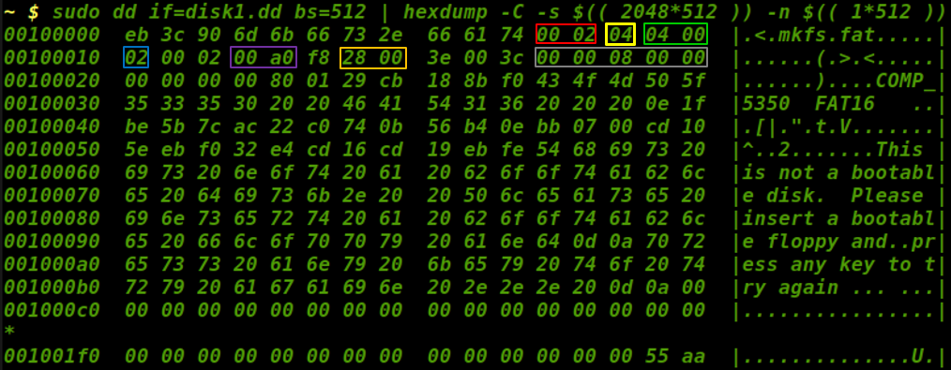
Important Information from Boot Sector
Bytes / Sector - 0x200 → 512
Sectors / Cluster - 0x04 → 4
# Sectors before Partition 0x0800 → 2048
Reserved Sectors - 0x0004 → 4
# FAT’s - 0x02 → 2
# Sectors - 0xA000 → 40960
Sectors / FAT - 0x0028 → 40
Root Directory Entries - 0x0200

Slide 14
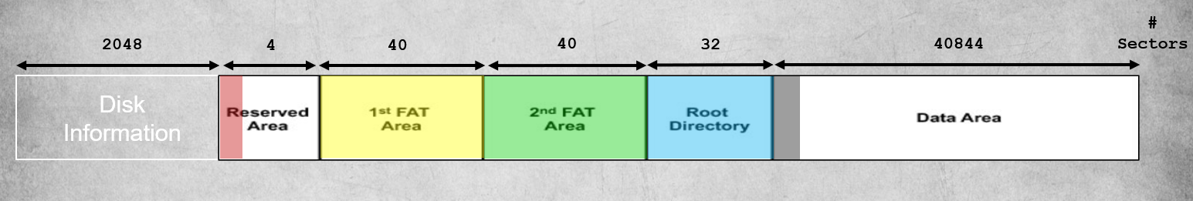
Mapping out the Architecture
Reserved Sector 4 Sectors - Obtained from Boot Record
FAT 40 Sectors - Obtained from Boot Record
Root Directory 32 Sectors - Number of Root Entries * 32 / 512

Slide 15
Navigating to Each Part
Reserved Area: sudo dd if=disk1.dd bs=512 | hexdump -C -s $(( 2048*512 )) -n $(( 4*512 ))
1st FAT: sudo dd if=disk1.dd bs=512 | hexdump -C -s $(( 2052*512 )) -n $(( 40*512 ))
Root Directory: sudo dd if=disk1.dd bs=512 | hexdump -C -s $(( 2132*512 )) -n $(( 32*512 ))
Data Area: sudo dd if=disk1.dd bs=512 | hexdump -C -s $(( 2164*512 )) -n $(( 4*512 ))

Slide 16
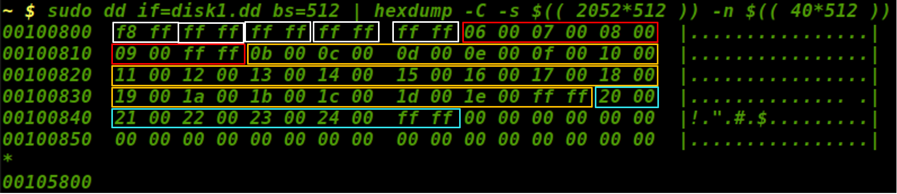
Examining the FAT
File 1 - (5 * 4 * 512) = 10,240
File 2 - (21 * 4 * 512) = 43,008
File 3 - (6 * 4 * 512) = 12,288

Slide 17
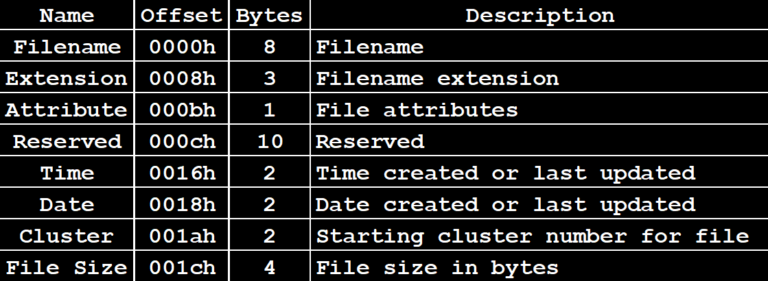
Examining the Root Directory Entries

Slide 18
File Status
0x00 - Filename Never Used
0xe5 - Filename used but Deleted
0x2e - Directory
0x41 - Normal File

Slide 19
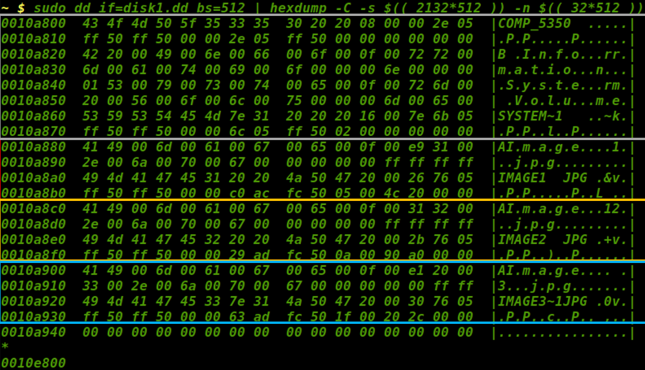
Examining the Root Directory

Slide 20
Gathering All the File Information
Collect all essential data about files in one location so that file retrieval is easier
Once all the data has been collected you can begin file extraction

Slide 21
File Extraction
Skip the clusters into the Data Sector
Check the location of the file
Image1 - sudo dd if=disk1.dd bs=512 | hexdump -C -s $(( 2176*512 )) -n $(( 1*512 ))
Image2 - sudo dd if=disk1.dd bs=512 | xxd -s $(( 2196*512 )) -l $(( 1*512 ))
Image3 - sudo dd if=disk1.dd bs=512 | xxd -s $(( 2280*512 )) -l $(( 1*512 ))
Carve the file
Image1 - sudo dd if=disk1.dd of=image1.jpg bs=512 skip=2176 count=20
Image2 - sudo dd if=disk1.dd of=image2.jpg bs=512 skip=2196 count=81
Image3 - sudo dd if=disk1.dd of=image3.jpg bs=512 skip=2280 count=23

Slide 22
New Technology File System
(NTFS)

Slide 23
NTFS
New Technology File System is a complex file system that provides greater functionality, reliability, security, and large storage device support when compared with File Allocation Table (FAT) versions

Slide 24
NTFS Partition Architecture
2,048 Sectors
1,024,000 Sectors
2,766,848 Sectors
Disk Information
NTFS
Partition
Unallocated
Note: The actual NTFS layout has never been published so this view is general and should not be taken as the data structure!
Master
Boot
Record
Master
File
Table
File
Data
Area
Master
File
Table
Backup

Slide 25
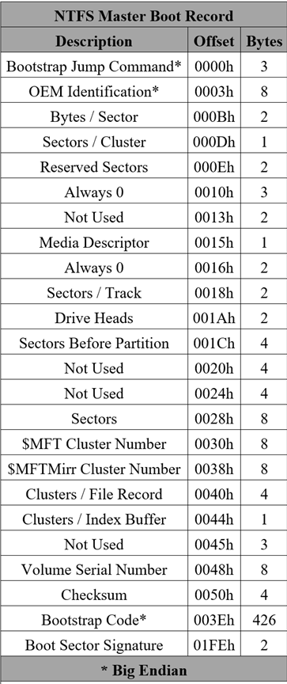
NTFS Master Boot Record (MBR)
The Master Boot Record (MBR) is the first sector of an NTFS partition
The MBR contains a partition table and a small amount of executable code like the FAT boot sector
The MBR finds the starting point of the partition and loads a copy of the boot sector into memory

Slide 26
NTFS Master File Table (MFT)
A Master File Table is composed of 1024-byte entries for every data object in the NTFS file system including files, folders, and applications and can be augmented with additional entries if necessary
The MFT initially accounts for ⅛ of the overall size of the NTFS partition and can grow to ½
MFT Entry
MFT Entry
MFT Entry
.
.
.
MFT Entry
MFT
Resident
Data
MFT
Metadata
Attributes
. . .
AH
Attribute
AH
Attribute
AH
Attribute
MFT
Entry
Header
(42 bytes)
512 bytes
512 bytes

Slide 27
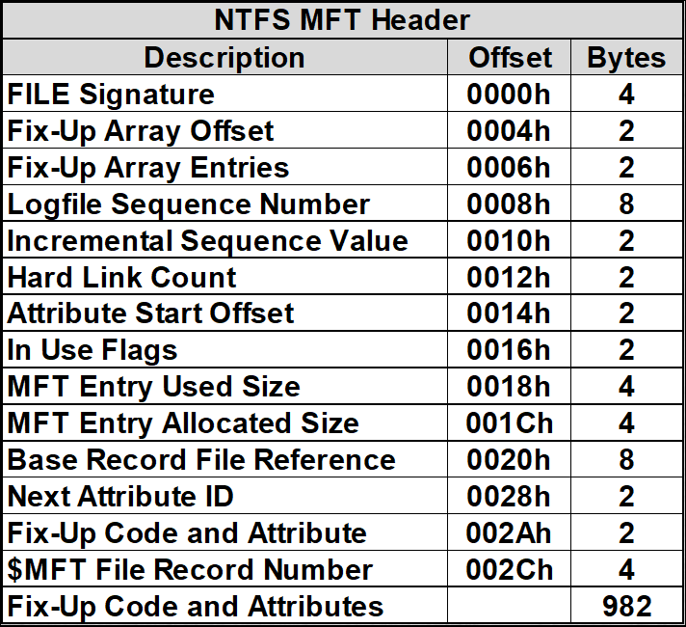
Master File Table Entry Header
The MFT is 1024 bytes long with the first 42 bytes making up the MFT header
The first 512 bytes of an MFT entry contains file metadata attributes
For files that are 512 bytes and less, the second 512 bytes can be used to store a file in the MFT entry
The first 39 MFT entries are reserved for system files

Slide 28
MFT Entry Header Definitions
Attribute Start Offset
Number of bytes before an attribute
Flags
MFT header flags specifying file status
0x01 – Record In Use
0x02 – Directory
Allocated Size
Space taken up by a record
Usually a multiple of cluster size
Base Record File Reference
Zero for base MFT records
Non-zero when an MFT reference

Slide 29
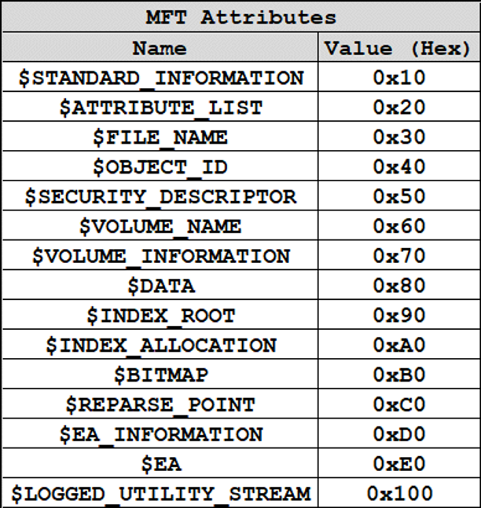
NTFS MFT Attributes
The NTFS file system defines each object as a file along with a set of file attributes
Elements such as the file's name, data, creation and modification time, and security information are file attributes
Each attribute is denoted with a unique attribute type value and attribute name
When a file's attributes and data can fit into the 1024 bytes of the MFT file record they are called resident

Slide 30
NTFS MFT Attributes
If a file's attributes and data can not fit into the MFT file record they are called non-resident
For non-resident attributes, it is necessary to allocate one or more clusters of disk space
If a MFT record grows beyond the allocated 1024 bytes, additional MFT records will be added and will generate an attribute list, which is also an attribute itself

Slide 31
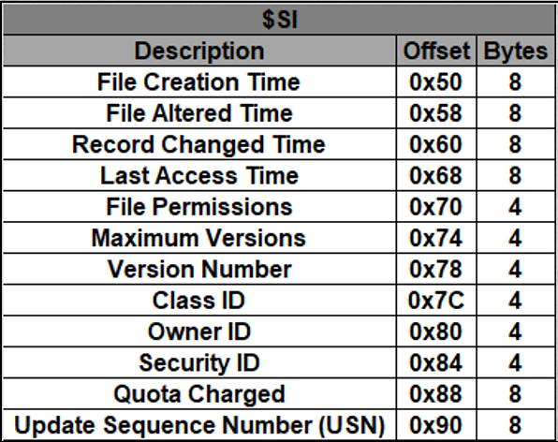
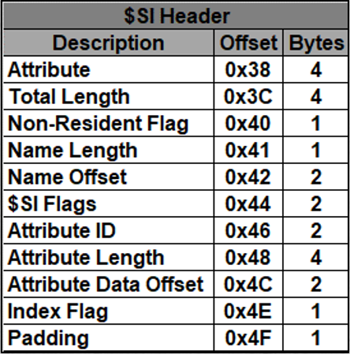
Standard Information Attribute
The $SI attribute exists for every file and directory and is always resident
$SI attribute identifier: 0x10

Slide 32
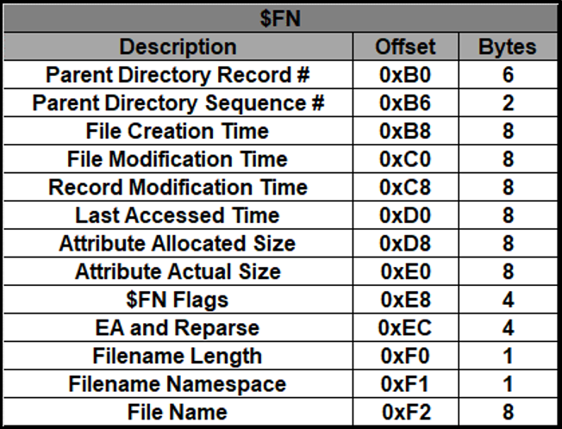
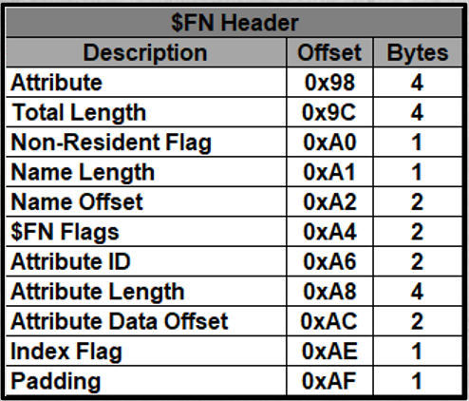
File Name Attribute
Stores the file name and parent directory of each file in the MFT entry
Stores data in a directory index
$FN attribute identifier: 0x30

Slide 33
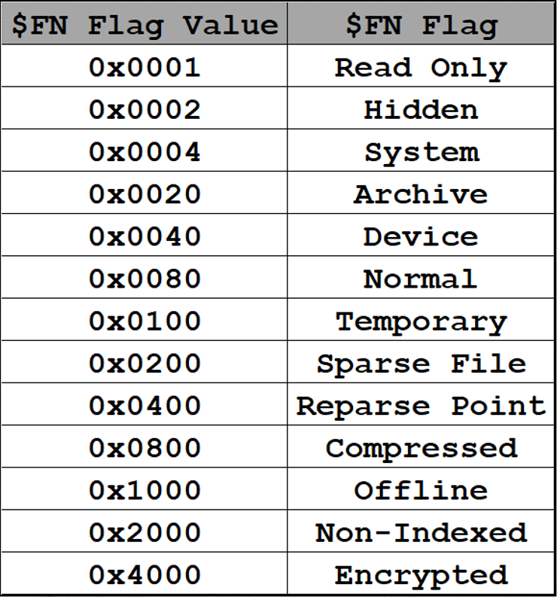
File Name Flags

Slide 34
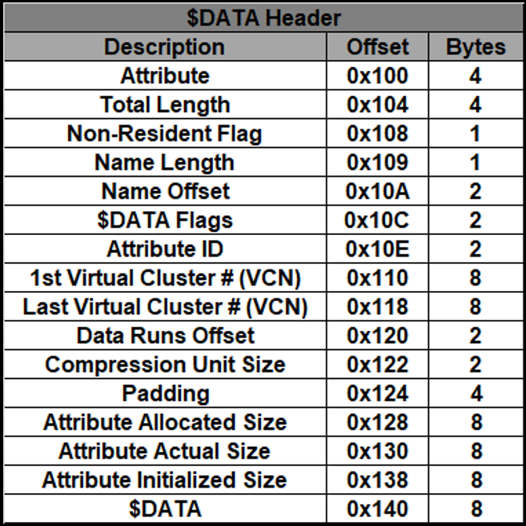
Data Attribute
The $DATA attribute does not have a structure
After the header, the remaining data corresponds to raw file data
$DATA attribute identifier: 0x80
$DATA has no minimum or maximum size
Raw data over 700 bytes in size is non-resident
For most files, the $DATA attribute is the last attribute in the MFT entry

Slide 35
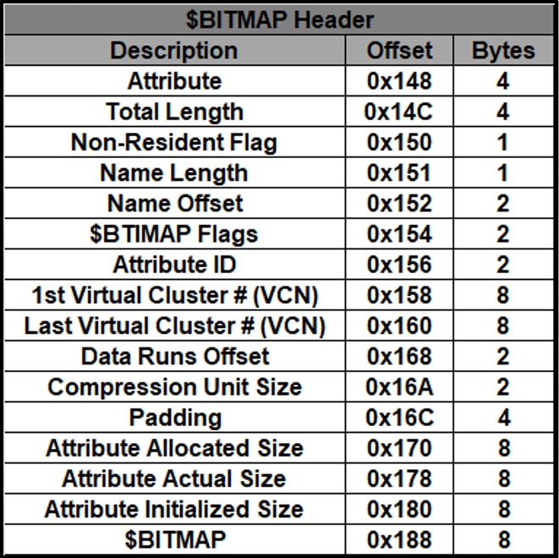
Bitmap Attribute
Describes the allocation status of each cluster in the file system
$BITMAP attribute identifier: 0xB0

Slide 36
NTFS Data Recovery Process
Determine NTFS Partition Offset
Analyze NTFS Master Boot Record
Identify System Generated Master File Table Entries
Identify User Generated Master File Table Entries
Classify Files as Existing or Deleted
Classify Files as Resident or Non-Resident
Locate File Contents
Recover File Contents

Slide 37
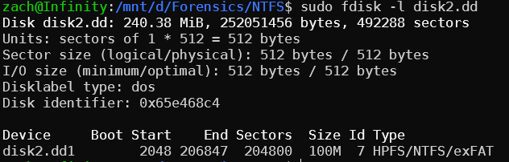
Determine NTFS Partition Offset
Sector Size: 512 bytes = 0x200
Start Sector: 2048 = 0x800
Start Partition Address: 0x800 * 0x200 = 0x100000

Slide 38
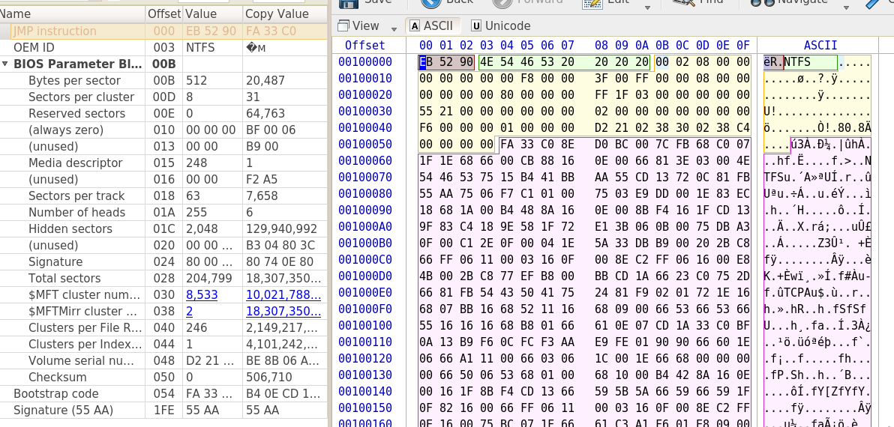
Analyze NTFS Master Boot Record
Bytes / Sector = 0x200
Sectors / Cluster = 0x8
Bytes / Cluster = 0x1000
Disk Offset = 0x100000
$MFT Cluster Number = 0x2155
MFT Location =
0x2155 * 0x1000 = 0x2155000
MFT Start Offset =
0x2155000 + 0x100000 = 0x2255000

Slide 39
Identify System Generated MFT Entries
MFT Location: 0x2255000
If formatted using Windows, 39 system entries
If formatted using Linux, 64 system entries
Each MFT entry is 1,024 bytes
39 * 1024 = 39,936 = 0x9C00
0x2255000 + 0x9C00 = 0x225EC00 (start of user generated MFT entries)

Slide 40
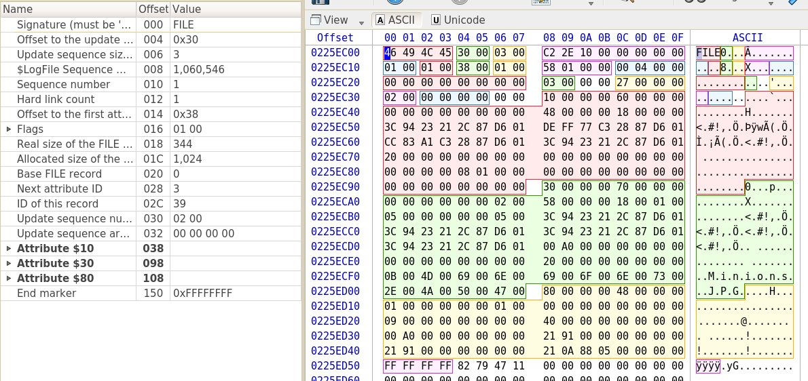
Identify User Generated MFT Entries
Located at offset 0x225EC00

Slide 41
Locate Files
Four user generated files are found
Minions.jpg (Non-Resident)
Start Cluster = 0x588
Start Sector = 0x588 * 8 = 0x2C40
Start Cluster Address = 0x2C40 + 0x800 (ntfs start sector) = 0x3440 = 13376
File size: 0x9121 bytes, 0x9121/0x200 ≈ 0x49 = 73 sectors
Simple.txt (Resident)
Start Offset = 0x225F120 = 36040992
File size: 0x26 = 38 bytes
Meow.jpg (Non-Resident)
Start Cluster = 0x592
Start Sector = 0x592 * 8 = 0x2C90
Start Cluster Address = 0x2C90 + 0x800 (ntfs start sector) = 0x3490 = 13456
File size: 0x86BB bytes, 0x86BB/0x200 ≈ 0x44 = 68 sectors
Rabbidz.jpg (Non-Resident)
Start Cluster = 0x59B
Start Sector = 0x59B * 8 = 0x2CD8
Start Cluster Address = 0x2CD8 + 0x800 (ntfs start sector) = 0x34D8 = 13528
File size: 0x9CA2 bytes, 0x9C82/0x200 ≈ 0x4F = 79 sectors

Slide 42
Recover Files
sudo dd if=disk2.dd of=Minions.jpg bs=512 skip=13376 count=73
sudo dd if=disk2.dd of=Simple.txt bs=1 skip=36040992 count=38
sudo dd if=disk2.dd of=Meow.jpg bs=512 skip=13456 count=68
sudo dd if=disk2.dd of=Rabbidz.jpg bs=512 skip=13528 count=79

